Slide 1
PROJECT DOOR STEP II
LONDON
Coal Pulp & Paper Credit Weather FX & Interest Rates
Office Visit- May, 2000
Report Issued- June ___, 2000
Confidential

Slide 2
Project Doorstep II - London
Review Highlights
Project Objective:
We performed an on-site review of processes, procedures and controls that support European Coal, Pulp & Paper, Credit Derivatives, Weather and FX & Interest Rates trading and origination business activities within the London office. Our procedures included interviews with key commercial and operations personnel. We also performed a test of commodity transactions from deal execution through to settlement entries.
Team Members: Office Personnel Interviewed:
Brent Price Tani Nath - Head of Global Products Operations
Jitendra Patel Stuart Staley - Vice President Coal Trading
Nicholas Swingler - AA Tim Poullain-Patterson - Global Products Controller
Hassaan Majid - AA Rebecca Millerchip - Head of Global Products Coordination Group
John Vickers - AA Lisa Kent - Coal Risk Management
Rebecca Morrill - AA Debbie Nicholls- Documentation, Coal and Pulp & Paper
Socrates Paschalis - AA Cornelia Luptovich- Manager, Coal Logistics
Scott Longmore - Coal Logistics
Robert Quick - Director, Legal (Coal, P&P)
Maya Beyhum - Trade Accounting (Coal, P&P)
Steve Kim - P&P trader
Martin Holmes - P&P Commercial Head
Catherine Woolgar - Weather Trader
Michael Nguyen - Weather Risk Management (Houston)
Bryan Seyfried - Vice President, Credit Derivatives
James New - Head Risk Management, Credit & Weather
David Wall - Manager, Credit Derivatives Risk Management
Ian Sloman - Head of Settlements, Credit & Weather
Gail Hill - Head of Documentation, Credit & Weather
Treena MacFarland - FX & Interest Rate Trader
Sheila Glover - Senior Director of Global FX & Interest Rate Operations (Houston)
Kenny Nichols- Coal Controller
Robert Richards- Weather Risk Management (Houston)
Hinesh Thakaria- Coal Settlements

Slide 3
Project Doorstep II - London
Observations
EFFECTIVE CONTROLS
Trading P&L and positions reported to Enron management in Houston on a daily basis.
FX/ Interest Rate Trading reports to Houston and is managed in a centralised manner.
Credit Trading Commercial, Risk Management, Documentation, Tax and Legal personnel have considerable experience in Credit Trading and are very knowledgeable about the business.
Formalised monthly reconciliation between Right Angle and Tagg with respect to physical coal deals.
All contracts which are not in English have been translated into English by qualified personnel.

Slide 4
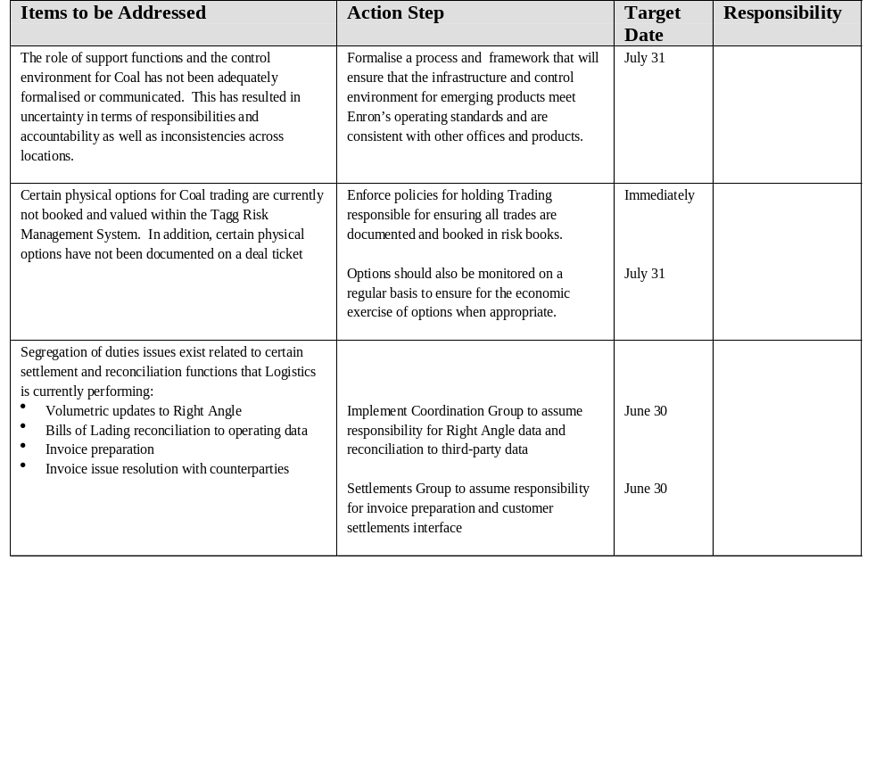
Project Doorstep II - London
Observations

Slide 5
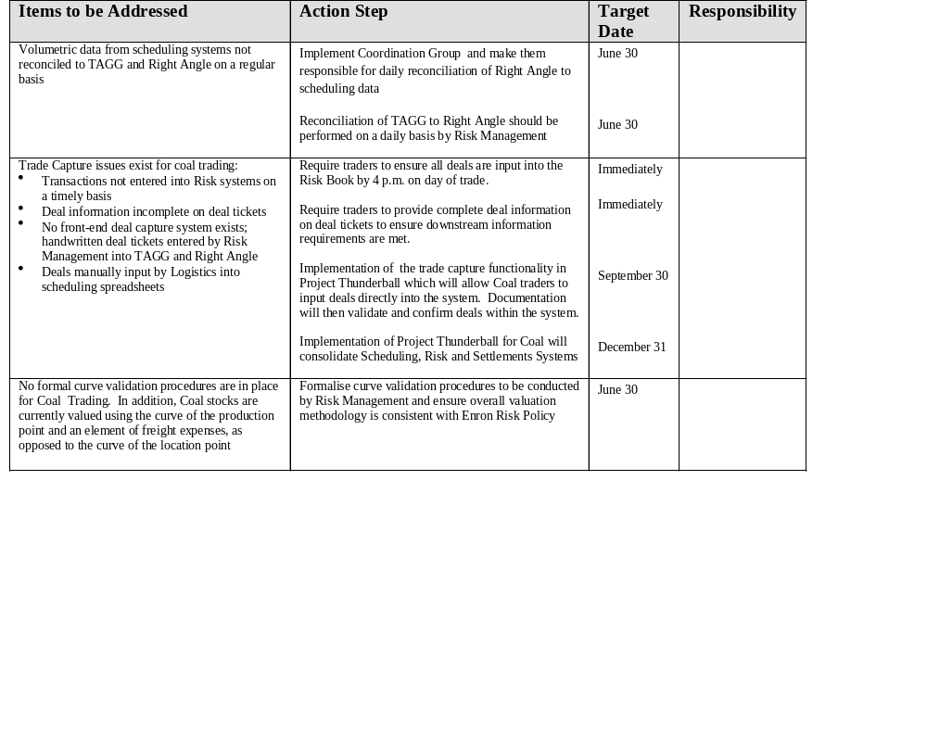
Project Doorstep II - London
Observations

Slide 6
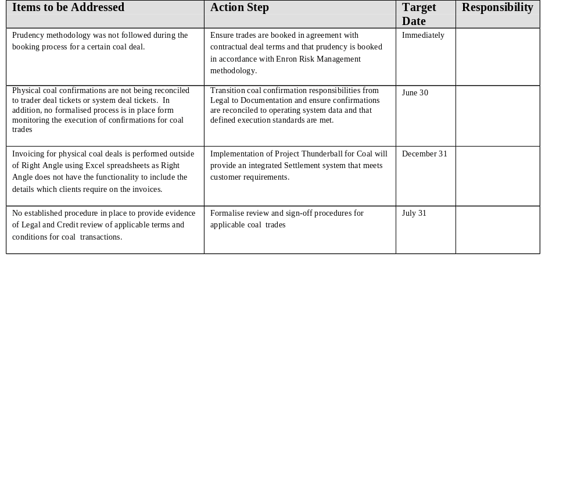
Project Doorstep II - London
Observations

Slide 7
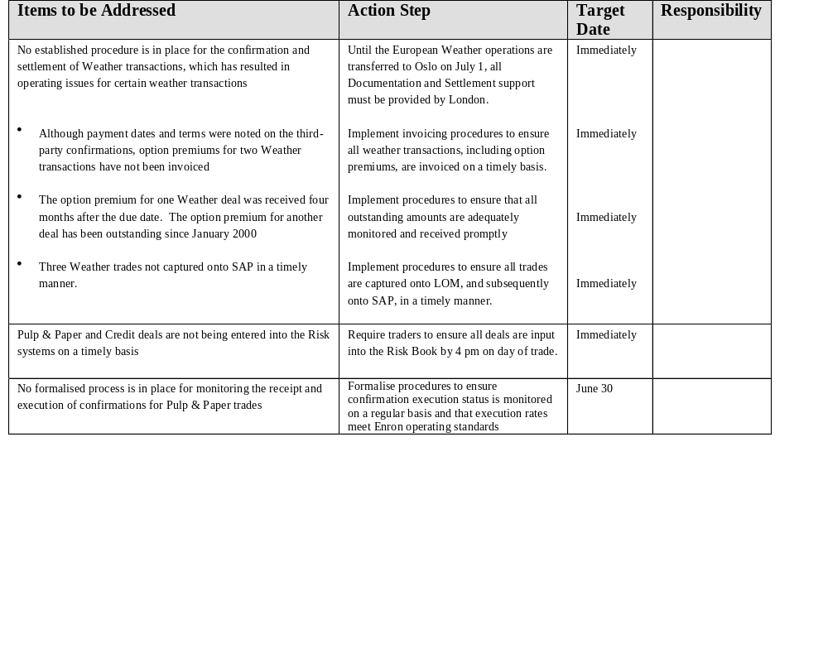
Project Doorstep II - London
Observations

Slide 8
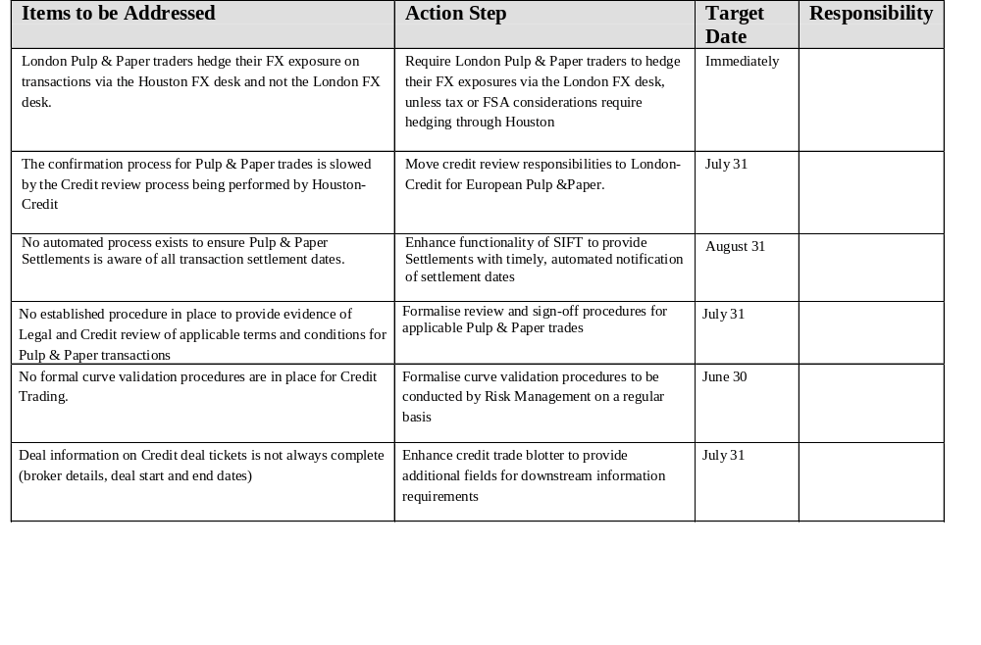
Project Doorstep II - London
Observations

Slide 9
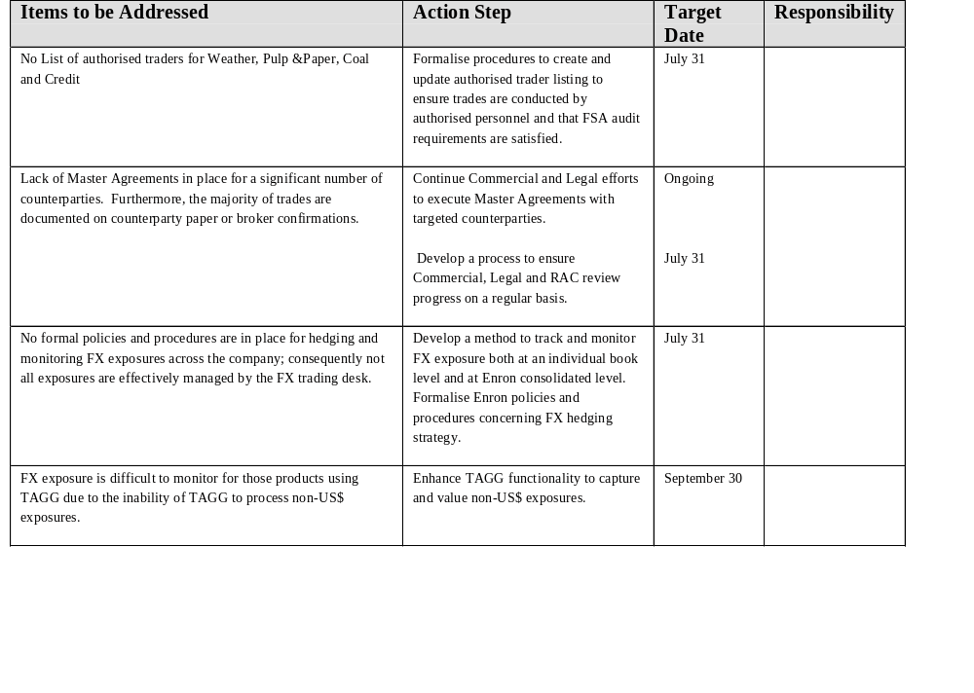
Project Doorstep II - London
Observations

Slide 10
Project Doorstep - London Observations
AREAS FOR FURTHER REVIEW
Interest Rates/FX aggregation & management process
Booking of physical coal options
Inventory Tracking capabilities for Coal
Credit Aggregation process
Valuation model review and booking methodology for new Credit products
Transition of European Weather Trading to Oslo on July 1

Slide 11
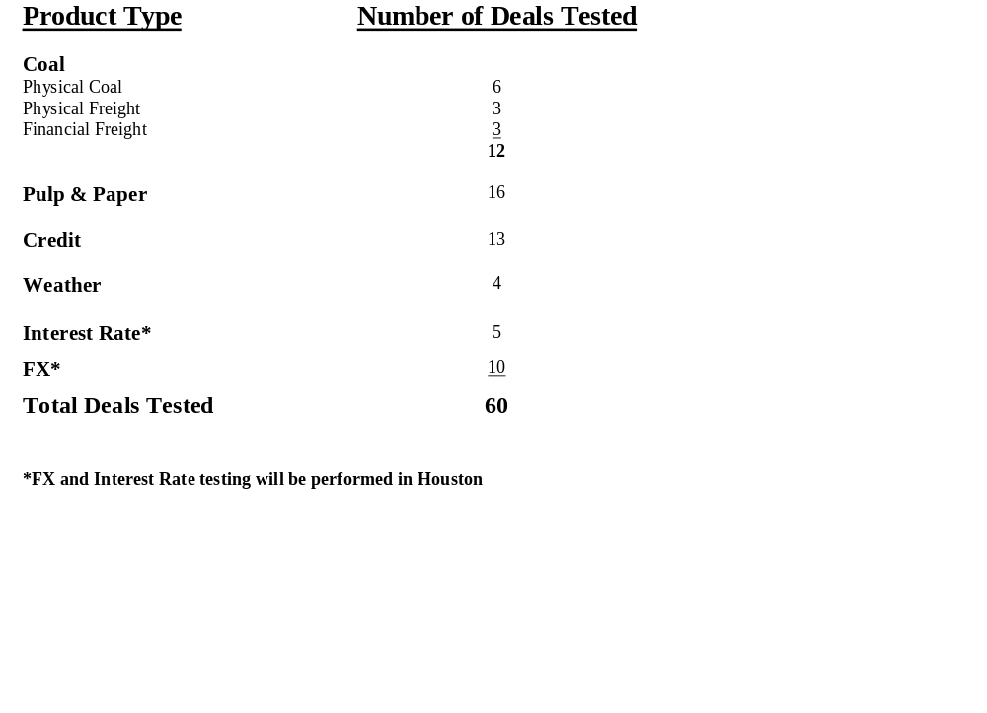
Project Doorstep II - London Deal Test Overview

Slide 12
Project Doorstep II - London
Attributes
Coal - Key attributes tested
Deal Capture
  Authorized trader
  Deal ticket sign off
  Deal details agree to TAGG
Documentation
  Confirmation creation date
  Time taken to create contract since trade date
  Authorized signatory
  Counterparty approval date
  Contract agrees to deal ticket and TAGG
Logistics: Physical Deals only
  Bill of Lading agrees to Right Angle
  Bill of Lading agrees to Coal Inventory Management System (CIMS)
  Bill of Lading agrees to TAGG
Settlement/ Accounting process
  Invoice/ Validation Sheets agrees to Right Angle(physical deals only)
  Counterparty Invoice agrees to Validation Sheet (purchases only)
  Invoices/ Validation Sheets agree to deal ticket data
  Deal ticket data agrees to LOM
  AR/AP entry
  Physical evidence of cash

Slide 13
Project Doorstep II - London
Deal Test Findings
Coal -Summary of test findings
12 deals were selected for detailed testing; selection included physical coal deals, financial freight deals and physical freight deals.
Summary of findings
No deal tickets available for 2 deals
Broker details omitted from deal ticket for 2 deals
No formal evidence of approval by Legal for all deals
TAGG is limited to USD currency prices only
TAGG is limited to $/tonne volumes only
Deal start and end dates not stated on 1 deal ticket
No signed Counterparty Confirmations for 2 deals
Payment authorisation not signed by Head of Global Product Settlements Group for 4 deals
No List of Authorised Coal Traders

Slide 14
Project Doorstep II - London
Deal Test Findings
Coal -Summary of test findings (Continued)
Input of deal ticket information to TAGG is not on a timely basis for 2 deals
TAGG backdated by 1 day to ensure deal included in the P&L pre-year end for 1 deal
Contract creation date is before deal ticket date for 1 deal
Contract created on an untimely basis for 1 deal
Price per deal ticket booked prudently and does not agree to price per contract

Slide 15
Project Doorstep II - London Attributes
Pulp & Paper - Key attributes tested
Deal Capture
  Authorized trader
  Deal ticket sign off
  Deal details agree to TAGG
Documentation
  Confirmation creation date
  Time taken to create contract since trade date
  Authorized signatory
  Counterparty approval date
  Contract agrees to deal ticket and TAGG
Settlement/ Accounting process
  Invoice/ Validation Sheets agrees to Right Angle(physical deals only
  Counterparty Invoice agrees to Validation Sheet (purchases only)
  Invoices/ Validation Sheets agree to deal ticket data
  Deal ticket data agrees to LOM
  AR/AP entry
  Physical evidence of cash

Slide 16
Project Doorstep II - London
Deal Test Findings
Pulp & Paper -Summary of test findings
All 16 deals were selected for detailed testing; all deals are financial
Contract date pre-dates deal ticket date for 2 deals
Deal ticket date is after deal start date for 1 deal
No deal ticket for 2 deals and Enron contracts do not state whether deals are buys or sells
No TAGG records for 1 deal
No formal documentation of the error/cancellation and subsequent re-booking by Houston
for 1 deal tested
Trade date per deal ticket is different to trade date on Enron confirmation for 1 deal
No formal documentation of Legal approval for all deals
ENA signed confirmation returned over 4 months after contract creation date for 1 deal
Interchangeable use of Enron entity abbreviated names

Slide 17
Project Doorstep II - London Attributes
Credit - Key attributes tested
Deal Capture
  Authorized trader
  Deal ticket sign off
  Deal ticket details agree to Control Sheet
Documentation
  Confirmation creation date
  Time taken to create contract since trade date
  Authorized signatory
  Counterparty approval date
  Date of approval by Legal
  Contract agrees to deal ticket
Settlement/ Accounting process
  Invoice agrees to contract payment terms
  Counterparty Invoice agrees to Validation Sheet (purchases only)
  Invoices/ Validation Sheets agree to deal ticket data
  Deal ticket data agrees to LOM
  AR/AP entry
  Physical evidence of cash

Slide 18
Project Doorstep II - London
Deal Test Findings
Credit -Summary of test findings
All 13 deals were selected for detailed testing; all deals are financial
Contract Confirmations not signed by Counterparty for 5 deals.
The initial payment date per deal ticket does not agree to contract for 5 deals.
Payment not entered on LOM for 1 deal.
No invoicing procedure has been planned for payments due to Enron.
No trade date field on Credit derivative deal tickets.
Invoice date per LOM is different to actual invoice date for 2 deals.
Trade date per Counterparty Confirmation does not agree to trade date per Excel deal database for for 9 deals.
The first credit derivative trade was not captured onto Excel deal database.

Slide 19
Project Doorstep II - London Attributes
Weather - Key attributes tested
Deal Capture
  Authorized trader
  Deal ticket sign off
Documentation
  Confirmation creation date
  Time taken to create contract since trade date
  Authorized signatory
  Counterparty approval date
  Date of approval by Legal
  Contract agrees to deal ticket
Settlement/ Accounting process
  Invoice agrees to contract payment terms
  Counterparty Invoice agrees to Validation Sheet (purchases only)
  Invoices/ Validation Sheets agree to deal ticket data
  Deal ticket data agrees to LOM
  AR/AP entry
  Physical evidence of cash

Slide 20
Project Doorstep II - London
Deal Test Findings
Weather -Summary of test findings
All 4 deals were selected for detailed testing; all deals are financial
For 2 out of 4 deals, no invoices had been sent out to the counterparties. At the time, there was no Settlements function
for the weather transactions. Invoices had been subsequently created for these deals for back-up purposes.
For 1 deal, the premium from the counterparty was paid in April but the due date was 4 months earlier.
Another premium, due from the counterparty in January, remains outstanding. Its status was only discovered as a
result of the testing.
For 2 trades, trade dates in the risk book were different from the trade dates on the confirmations and deal tickets
The details of the last 3 trades were not entered in LOM until 31/05/00.
The templates used for confirmations by the US and the UK are not identical.
Confirmations were not dated by the legal department in all 4 deals and was not dated by the counterparty in 2 trades.
The deal ticket was not signed by the trader for 3 trades.

